Slide 1
Game Description Analysis & Keyword Suggestions
Faculty of Computer Science
Instructor: Dr Alireza Manashty
Presented by: Somi Deepthi & Keerthi Mettu
April 17, 2020

Slide 2
Team Roles
BI Analyst
Data Engineer
Data Scientist
Communicator

Slide 3
Table of Contents:
Introduction
Problem Statement
Solution Overview
Benefits of this project
Project value and details
Requirements
Data Analytics life cycle
Tools
About development
Output details
Conclusion
References

Slide 4
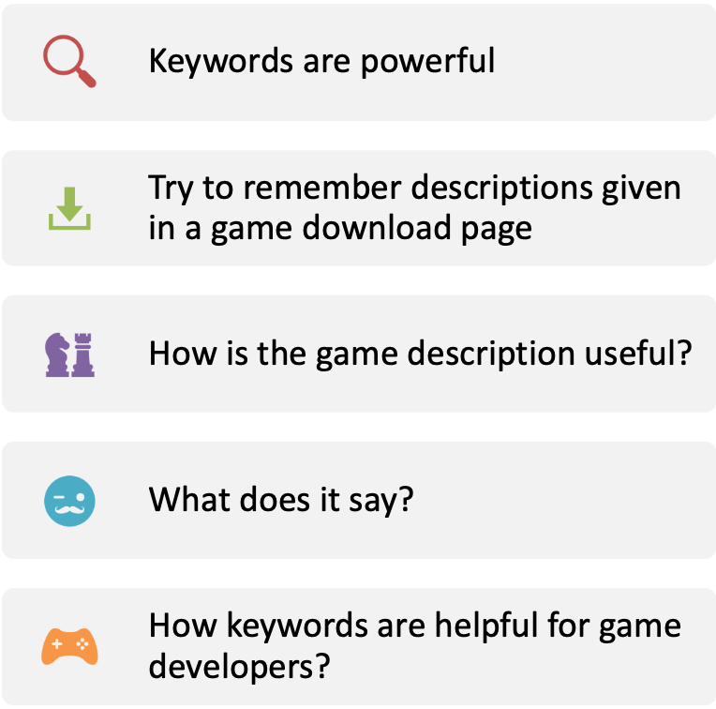

Introduction
FRR95G.jpg

Slide 5
Problem Statement
Many factors may have contributed to the probability of a game to be successful and reachable to wide number of users.
There is a need to analyze the game description which intends to suggest proficient keywords that can be added to the existing or new description content to improve its readability.
The main idea of the project is to provide keywords/phrases to developers that constitute to the idea/theme of the game which will tell them what the game is about in the description itself.

Slide 6
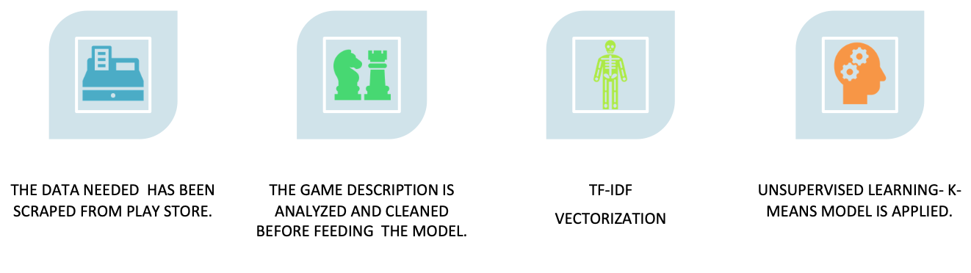
Solution Overview
By applying above functionalities, given a game description by any user, the developed model would provide a valid suggestion of keywords/ phrases that need to added to the game description apart from existing one’s, also the phrases that are not likely to be added.

Slide 7
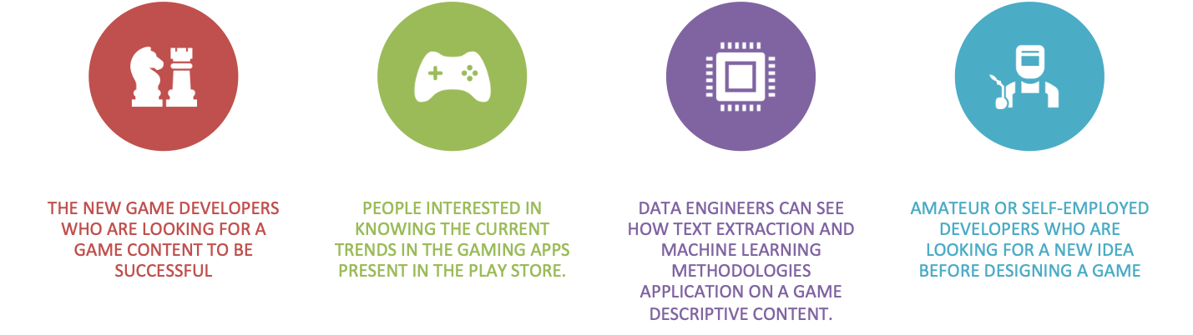
Who does benefit from this project?

Slide 8
Value of this project
This application can be used by all game developers
Every year there is a rise of these developers by around 5 million
Hit ratio of successful games are really huge
Expected to have 160+ billion USD revenue from entire gaming industry in 2020
More than 2400 game development companies can increase their market demand and shares.

Slide 9
The project is all about:
Research Analysis for game developers about trends.
Know what is more successful game kind in Google play store
Know what are most demandable features that are most likely interested by gamers
Help developers to be on a success streak
Being a guideline for new game developers

Slide 10
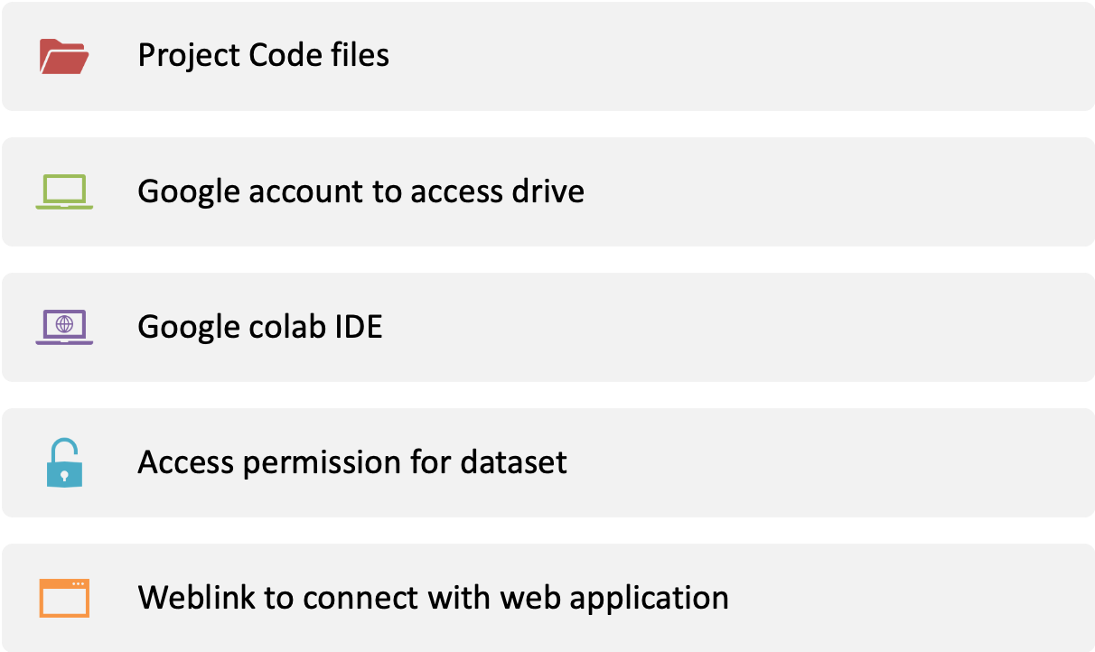
Requirements of Project

Slide 11
What is done in Data Analytics Lifecycle
Before the development begins, the revenue hikes that are brought from this project are explained.
Development team is responsible for delivering the status periodically.
Executives are the business users or stakeholders who wants to have a product exactly how the end users would use.
Executives have to be communicated in every phase about the measures that were followed and implemented in development.
Executives helps in the costs of development of each phase.

Slide 12
Tools for development
Python
Google Colab
Google Drive
Google play scrapper, Beautiful Soup for scrapping
Numpy, pandas, string, re for computations
NLTK library for text extraction
SKLearn for vectorization and modelling
Matplot, Seaborn for visualization
Flask for web connections
Tensor Flow

Slide 13
Project Development
15k+ games data is collected from the Google play store
Description is the key feature in every game that is required to build a model
Followed all ETL techniques related to the text content
The data is vectorized creating columns for each unique word
Clustering Model is applied on this vectorized data
Clusters are grouped based on specific features
Predictions from the trained model are observed
Iterating this process and model training to get excellent results

Slide 14












High level project view
Visualization
Filtering &
cleaning
Model identification
Dataset creation
Clustering
Analysis by text reading
Automation helps more people
Games data
Trend results

Slide 15
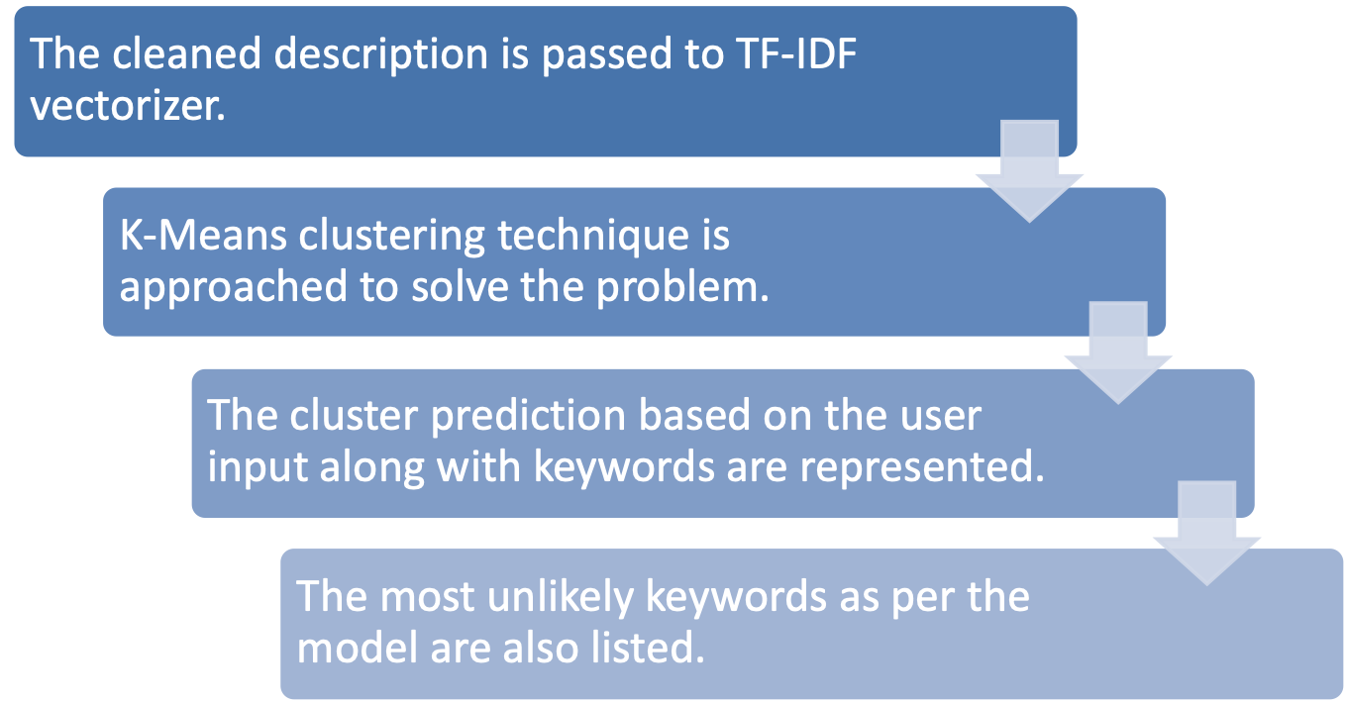
High – Level Model Development:
Notes:
A survey conducted in 2015 showed that 83% of text-based recommender systems in digital libraries use tf–idf.[

Slide 16
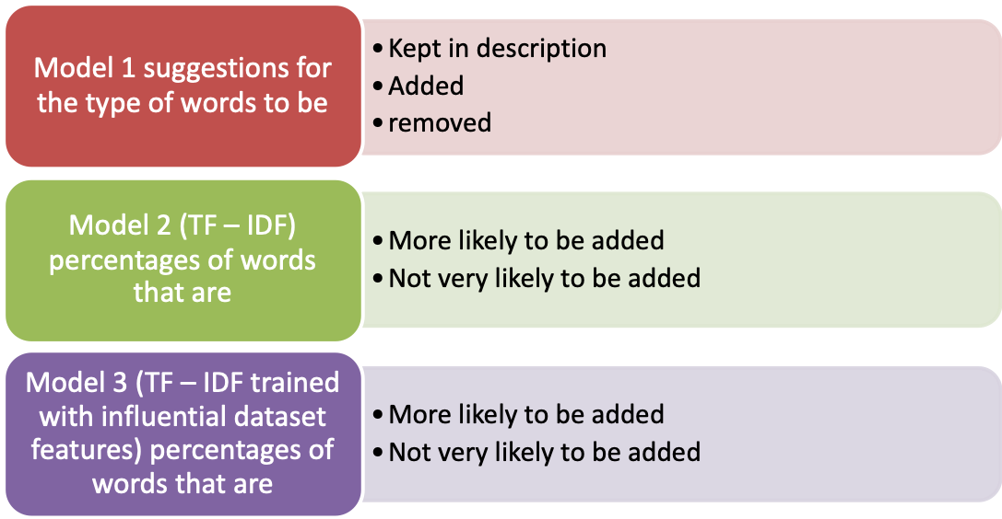

What is seen in the output?

Slide 17
Requirements to see the output
A google account to run the final results page in Google colab.
Project file (just the results processing one)
Access and permission to mount the google drive on to this results file
A web link of this project to display the results on a browser
Need to provide a sample description sentence to see the model suggestions and predictions

Slide 18
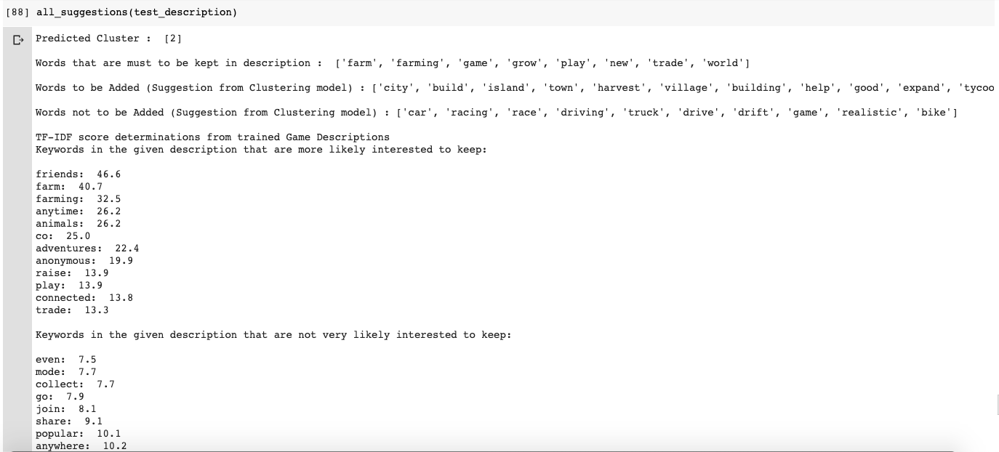
Output

Slide 19
Conclusion:
The keywords generated can help the developers with intellectual game description that is appropriate to game features when embedded.
As the word/phrases to be kept, to be added and to be removed were explicitly mentioned, it can accurate the description and elongate in accordance with the game and its credibility.

Slide 20
References
[1] “Steam: Game and Player Statistics.” Steampowered.Com, 2019, store.steampowered.com/stats/. Accessed 2 Feb. 2020.
[2] Juzel Albert Padilla. “2019 Video Game Industry Statistics, Trends & Data.” WePC.Com, WePC.com, 15 May 2018, www.wepc.com/news/video-game-statistics/. Accessed 2 Feb. 2020.
[3] Jones, Alison. “The Most Popular Video Game Genres in 2019 | Invision Game Community.” Invision Game Community, 17 May 2019, invisioncommunity.co.uk/the-most-popular-video-game-genres-in-2019/. Accessed 29 Jan. 2020.
[4] “U.S. Most Popular Video Game Genres 2017 | Statista.” Statista, Statista, 2017, www.statista.com/statistics/189592/breakdown-of-us-video-game-sales-2009-by-genre/. Accessed 29 Jan. 2020.
[5] Dobrilova, Teodora. “14 Mobile Gaming Statistics, 2019 - Insights Into $2.2B Gamers Market.” Tech Jury, Tech Jury, 22 Mar. 2019, techjury.net/stats-about/mobile-gaming/#gref. Accessed 30 Jan. 2020.
[6] “Supervised vs Unsupervised Learning: Key Differences.” Guru99.Com, 21 Sept. 2019, www.guru99.com/supervised-vs-unsupervised-learning.html. Accessed 30 Jan. 2020.
‌[7] Deyan G. “33 Out Of This World Video Games Industry Statistics In 2020 - Tech Jury.” Tech Jury, Tech Jury, 23 Apr. 2019, techjury.net/stats-about/video-games-industry#gref. Accessed 30 Jan. 2020.
[8] Wikipedia Contributors. “List of Video Game Developers.” Wikipedia, Wikimedia Foundation, 15 June 2019, en.wikipedia.org/wiki/List_of_video_game_developers. Accessed 1 Feb. 2020.
‌[9] “Global Game Developers by Region 2017 | Statista.” Statista, Statista, 2017, www.statista.com/statistics/453785/game-developer-region-distribution-worldwide/. Accessed 1 Feb. 2020.
[10] Takahashi, Dean. “The U.S. Game Industry Has 2,457 Companies Supporting 220,000 Jobs.” VentureBeat, VentureBeat, 14 Feb. 2017, venturebeat.com/2017/02/14/the-u-s-game-industry-has-2457-companies-supporting-220000-jobs/. Accessed 1 Feb. 2020.
[11] “Free Online Gantt Chart Maker.” Office Timeline, 2019, www.officetimeline.com/online/gantt-chart-maker. Accessed 1 Feb. 2020.
[12] Sanatan Mishra. “Unsupervised Learning and Data Clustering.” Medium, Towards Data Science, 19 May 2017, towardsdatascience.com/unsupervised-learning-and-data-clustering-eeecb78b422a. Accessed 2 Apr. 2020.
[13]“Play-Scraper.” PyPI, 15 Sept. 2019, pypi.org/project/play-scraper/. Accessed 8 Feb. 2020.
[14] Paul, Sayak. “K-Means Clustering with Scikit-Learn.” DataCamp Community, 2018, www.datacamp.com/community/tutorials/k-means-clustering-python. Accessed 9 Feb. 2020.
‌[15] “Ch03.Rst2.” Nltk.Org, 2010, www.nltk.org/book/ch03.html. Accessed 8 Mar. 2020.

Slide 21
Thank you ☺

